Slide 1
Protecting Against Identity Fraud
Case Study

Slide 2
Personal Experience
I am a professional internet Junkie! I absolutely buying things online. I love shopping for, and searching out the best deals and products that I like to buy and sell. More specifically, I have been buying and selling video games and consoles online for nearly 20 years. Mostly on eBay and Amazon. One day, I woke up early in the morning to an alert from ebay on my phone with the following congratulatory message: You’ve won! Your item has shipped!

Slide 3
Personal Experience
The only problem was, that I hadn’t ordered anything and it became painfully evident my eBay account had been hacked. What was the motivation behind this action? Apparently, someone really, really wanted this:

Slide 4
Personal Experience
A state of the art, SoundCraft Ui24R Digital Mixer! I could hear the hi fidelity as I read description. Except, I didn’t want or request this item. Nor did I ever receive it.
Unfortunately, however, the thieves were able to charge my credit card in full for the item, as evidenced by my PayPal receipt for $885.00!

Slide 5
What is the first thing you do if you’re a victim of identity theft?
Stop any further damage – Go to each credit reporting agency and place a credit freeze on your account
Experian
Transunion
Equifax

Slide 6
Experian Website: https://www.experian.com/blogs/ask-experian/how-to-freeze-your-credit-report-for-free/

Slide 7
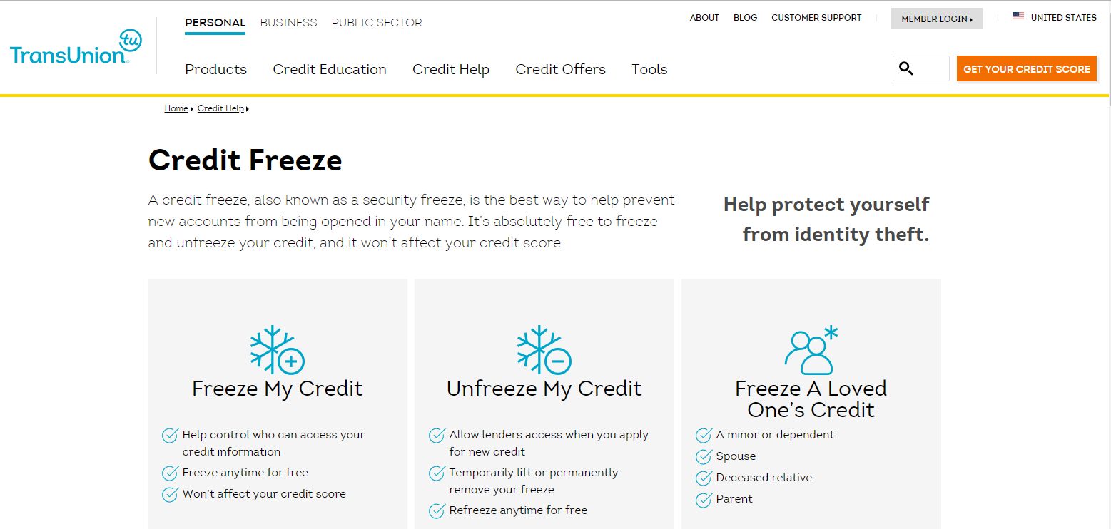
Transunion Website: https://www.transunion.com/credit-freeze

Slide 8
Equifax Website: https://www.equifax.com/personal/credit-report-services/credit-freeze/

Slide 9
You’ve potentially stopped future fraudulent credit openings in your name, are there any existing fraudulent accounts in your name? How do you know?
You need to get a copy of your credit report from each of the credit reporting agencies and look at all open credit in your name.
By law, Credit Reporting Agencies are required to provide you, at your request, a free credit report from each of the three major credit reporting agencies every 12 months. If you suspect fraud, you will want to order all three reports immediately. One report from each of the agencies.
There are two websites you need to visit. The first is the Federal Trade Commission website:
https://www.consumer.ftc.gov/articles/0155-free-credit-reports

Slide 10
FTC Website
The FTC website will give you good general information about how to protect your personal information as well as a link on where to go to order your free credit reports.
The second website is where you can order your free credit report. The name of the website is:
https://www.annualcreditreport.com/index.action

Slide 11
Annualcreditreport.com
Q: What information do I need to provide to get my free report?
A: You need to provide your name, address, Social Security number, and date of birth. If you have moved in the last two years, you may have to provide your previous address. To maintain the security of your file, each nationwide credit reporting company may ask you for some information that only you would know, like the amount of your monthly mortgage payment. Each company may ask you for different information because the information each has in your file may come from different sources.

Slide 12
With Credit Freezes in Place and Credit Reports Reviewed, How do I resolve established fraudulent accounts?
Now that you’ve setup a credit freeze on your credit profiles, and you’ve reviewed your credit report for fraudulent accounts, what is next?
This step is the hardest step. You need to contact each and every creditor that you have identified as a fraudulent account, inform them of the identity fraud, and work with the creditor to freeze/shut down the account and work to resolve the fraud.
Many times the account has been opened for quite some time and delinquent or past due balances may already exist due to the fraudster accessing your information. This can be catastrophic to your credit score and credit report. What’s the difference between the two?
Almost always, the mailing address and contact email/phone numbers on the account will be different than the real ones. This is because the fraudster does not want the victim to receive any notifications about the fraud being perpetrated.
How can we protect ourselves from this happening in the first place?

Slide 13
Personal Experience
Fortunately, for me, there is a happy ending to my story. I was able to contact eBay, Paypal, my credit card issuer, and my bank within hours of the fraudulent transaction to explain that I did not authorize the purchase of this item and that I had been a victim of identity theft.
The fees were reversed, I placed a credit hold on all three of my credit reporting accounts, reviewed each credit report and was fortunate enough to find that no fraudulent accounts had been opened using my credit information.
I was thoroughly relieved but gained an experience that would change how I behave both online and in person for the rest of my life.

Slide 14
Identity Theft Prevention Tips
When dealing with websites online, make sure that the web address has an “s” after the http to ensure that it is a secure website
https://www.consumer.ftc.gov/articles/0155-free-credit-reports
Do not save your login credentials on your computer
Request a second verification code for website access under your account
Get text notifications of any transaction on your credit accounts i.e. spending amounts, change of billing address, funds transfers, etc.
Change your passwords frequently
Do not post personal information about yourself or family on social media i.e. birthdays, address, vacation plans, etc.

Slide 15
CASE 1 Scenario
An entrepreneur had her identity stolen while she was out of the country on business. She connected through social media to keep up with friends. Thieves took her mail while she was away and attempted to open 17 accounts. They succeeded in spending $15,000 before the theft was detected. She is still trying to repair the damage to her credit report.
What could this businessperson have done to prevent thieves from stealing her identity?

Slide 16
CASE 1 Solution
Solution: Be sure to have the post office hold your mail while you are out of the country or on any extended trip. An overflowing mailbox is a signal to thieves that you are away. It is always important to make sure your mailbox is secure, in a secured area. The businessperson might be more careful discussing a trip while still on it. Tweeting details or posting pictures with time and location identifiers could have provided a dishonest acquaintance with a crime of opportunity. Unsecure mail made it easier.

Slide 17
CASE 2 Scenario
A 21-year-old waitress in a small town became an identity theft victim when thieves stole her renewed driver’s license out of her mailbox. She realized it when she received a credit card in the mail for which she had not applied. The thief was able to use the stolen identification to open several credit card accounts and is still at large.
What could this waitress have done to ensure she received her driver’s license safely?

Slide 18
CASE 2 Solution
Solution: The waitress could request that the license be held at the Department of Motor Vehicles for pick up, or sent to a secure mailbox. It may be possible to request that the license be delivered by certified mail, which requires a signature from someone who is at that address.

Slide 19
CASE 3 Scenario
A university student’s wallet was stolen, but he didn’t think the thieves wanted more than the cash so he did not report the theft to police right away. Within hours, the thieves had emptied his checking account using his debit card and charged $5,000 worth of purchases on his existing credit cards. They also started the process to open new credit accounts in his name. However, it took months for him to learn the full extent of the theft. Card issuers started sending notices and calling, looking for payment on credit cards he knew nothing about. More than six months after the incident, the student is still trying to straighten out his credit. He cannot request a loan or open a credit card account because of the damage to his credit report.
What could this university student have done to prevent the thieves from causing this much damage to his credit history?

Slide 20
CASE 3 Solution
The moment he noticed his wallet was missing, he should have immediately notified police, all his card issuers, and his bank. Never assume that the thieves will only take your cash and leave your cards in the trash. While the student is not generally liable for unauthorized transactions on his accounts, it is still a hassle to straighten out. It can take hours and hours to sort out all instances of identity theft. He also should have put an alert on his credit reports. This would have signaled to card issuers that a thief might be trying to open an account in his name. They would then take special measures to verify who was applying for credit.

Slide 21
CASE 4 Scenario
Dozens of online financial scams have been reported. In one, criminals create a Web site that looks legitimate. It may even appear to be a reputable site you have visited before. Then, posing as reputable companies, they send emails asking people to confirm personal and financial information by clicking on a link within the email that takes the reader directly to their phony site. One notable instance of this scam involved criminals posing as the online auction giant, eBay. They sent emails stating, “Your purchase of a tablet for $599 plus shipping and handling is being processed. If you believe this notice is incorrect or if you wish to cancel this order, please click on the link below and fill out the required information to stop the order.” The “required information” being requested turned out to be a Social Security number, credit card number and other financial data. Anyone who responded also confirmed that the email address being used was “live” or active.
What can you do to ensure that an email request for information you receive is legitimate?

Slide 22
CASE 4 Solution
If you receive an email requesting detailed financial and personal information, take a moment to call the company to verify the request. You can also directly access the Web site through your browser (do not click on the link provided in the email) to check if they are updating information. In the case of the eBay scam, it would have been a good idea to call the company, report the email and check if they sent it out in error. You should also report all email scams to the police.

Slide 23
CASE 5 Scenario
A university student’s wallet was stolen, but he didn’t think the thieves wanted more than the cash so he did not report the theft to police right away. Within hours, the thieves had emptied his checking account using his debit card and charged $5,000 worth of purchases on his existing credit cards. They also started the process to open new credit accounts in his name. However, it took months for him to learn the full extent of the theft. Card issuers started sending notices and calling, looking for payment on credit cards he knew nothing about. More than six months after the incident, the student is still trying to straighten out his credit. He cannot request a loan or open a credit card account because of the damage to his credit report.
What could this university student have done to prevent the thieves from causing this much damage to his credit history?

Slide 24
CASE 5 Solution
Keeping a debit card in an unlocked or open location can invite trouble. Keep your debit card with you, or concealed in a safe location at all times. NEVER tell anyone your PIN, and never store it anywhere someone might find it or write the PIN on the card. Don’t choose a PIN someone can easily figure out. Always record your transactions and keep receipts in a safe place until you destroy them after reconciling your statements. Be aware that receipts for off-line debit transactions may contain your entire account number. Remember that debit cards often have the option to sign, so you do not need a PIN to use it. This case can present an opportunity to discuss the fact that, sadly, it’s not always possible to trust acquaintances, and even friends have been known to take cards without permission. Consider discussing with participants how to safeguard their credit or debit card, as well as their friendships, by keeping their cards private and out of reach.

