Slide 1
APS: Working Together with Multi-Jurisdictions

Slide 2
Abuse,
Neglect,
Exploitation:
At least 10% of adults age 65 and older will experience some form of elder abuse in a given year, with some older adults simultaneously experiencing more than one type of abuse.
~ Elder Justice Initiative
Notes:
justice.gov

Slide 3
Mandatory Reporting Under Utah Law
(UC §62A-3-305(1))
“Any person who has reason to believe that any vulnerable adult has been the subject of abuse, neglect, or exploitation shall immediately notify Adult Protective Services intake or the nearest law enforcement agency. When the initial report is made to law enforcement, law enforcement shall immediately notify Adult Protective Services intake. Adult Protective Services and law enforcement shall coordinate, as appropriate, their efforts to provide protection to the vulnerable adult.”
Notes:
Comment that it is similar to child abuse.
Failure to report is a class B misdemeanor (UCA 76-5-111.1(4))

Slide 4
Vulnerable Adult
An elder adult, 65 years of age or older.
An adult (18-64) who has a mental or physical impairment which substantially affects that person’s ability to:
Provide personal protection;
Provide necessities such as food, shelter, clothing or, mental or other health care;
Obtain services necessary for health, safety, or welfare;
Carry out the activities of daily living;
Manage the adult’s own financial resources; or
Comprehend the nature and consequences of remaining in a situation of abuse, neglect, or exploitation.
Notes:
Utah Code Annotated 62A-3-301(30)

Slide 5
APS Intake Criteria
APS shall accept all referrals with allegations of abuse, neglect, or exploitation of a vulnerable adult in the State of Utah except as follows:
When the referral does not involve an allegation that a vulnerable adult may have been or is being abused, neglected or exploited;
When the referral does not identify a current abuse, neglect or exploitation allegation, but anticipates that abuse, neglect, or exploitation may occur;
When the referral involves a vulnerable adult on an Indian reservation;
When the referral involves an alleged incident in a long-term care facility involving an alleged theft or alleged loss of a resident’s money and/or personal property, the alleged perpetrator(s) is unknown, and the money and/or personal property has been replaced, returned, or reimbursed by the facility;
When the referral involves an alleged financial scam and/or alleged consumer fraud;
When the referral contains insufficient information to locate the alleged victim.
Notes:
Discuss Tribal contacts.
Utah Administrative Rule 510-302-6

Slide 6
HOW TO REPORT
Intake Hotline
1-800-371-7897
Monday - Friday
8:00 am to 5:00 pm
Email
APSIntake@utah.gov
Fax
1-801-715-3428
Reports can be made 24/7 online. To submit a referral go to:
www.daas.utah.gov
Notes:
Email was specifically set up to receive law enforcement reports, however you may get a call back if all information is not included.

Slide 7
Federal Reporting
The United States Attorney’s Office for the District of Utah considers financial fraud committed against the elderly as a high priority of cases to be prosecuted by the Financial Crimes Section. For that reason, cases with lower loss amounts will be considered for Federal prosecution.
Common cases include: romance scams, mass mailings targeting the elderly, telemarketing cases, fake kidnappings, and lottery cases to name a few.
To have a case screened for federal prosecution, contact Special Agent Drew Scown (FBI) at 801-579-1400.
For cases involving mail, contact US Postal Inspector Travis Smoot at 801-887-1923.
For state prosecutors or law enforcement who wish to screen a case directly with the United States Attorney’s Office, contact Elder Fraud Coordinator AUSA Kevin Sundwall at 801-325-1407.

Slide 8
Adult Protective Services
What APS Can Do:
Perform protective needs assessments
Coordinate with, or make referrals to, community resources and services
Provide short-term, limited services to a vulnerable adult when family or community resources are not available to provide for the protective needs of the vulnerable adult.
What APS Cannot Do:
Enter an adult’s home without consent
Take custody of an adult
Conduct welfare checks
Provide any service without voluntary consent of the victim, unless court ordered
Investigate if victim is deceased
Notes:
(except in the event of exigent circumstances or if the vulnerable adult is in imminent harm)

Slide 9
APS Investigative Process
If an accepted referral is not an emergency, the APS investigation is initiated within three working days.
If the referral is an emergency that may involve imminent harm, APS will immediately contact local law enforcement and initiate the investigation within one hour.
The investigator gathers information to make determinations on each allegation of abuse, neglect or exploitation.
The investigator makes a determination on the case:
Without Merit
Inconclusive
Supported
Findings are administrative, not criminal
Notes:
Discuss if cases are supported, how we work with LE, Attorneys, and the AP’s right to appeal.
Talk about after hour emergencies.

Slide 10
APS Investigative Process
Adult Protective Services shall respect the lifestyle that is knowingly and voluntarily chosen by the vulnerable adult.
A vulnerable adult with capacity to consent has the right to self-determination.
All services provided are voluntary unless court ordered.
A vulnerable adult abuse case has many stages from the incident through investigation, prosecution, and victim recovery.
Notes:
Discuss the importance of this administrative rule,especially as it pertains to self-neglect and victim with capacity declining the investigation.

Slide 11
Utah APS Investigations FY21
APS investigated 4,006 cases of abuse, neglect, and exploitation of vulnerable adults.
60% female, 40% male
64% of allegations occurred in their own home
51% of alleged perpetrators were a family member or relative
Of those cases, 5,812 allegations were investigated, with the top three allegations being:
1487 Financial Exploitation
1169 Emotional Abuse
1083 Caretaker Neglect
Notes:
Data represents Utah, we will customize data to an area when applicable.
FY19 2.56% support rate.

Slide 12
Allegation Types
ABUSE
NEGLECT
EXPLOITATION
Physical
Emotional
Sexual
Unlawful Restraint
Deprivation of Treatment
Isolation
Caretaker
Self-Neglect
Financial
Criminal Activity
Sexual
Personal Dignity
Notes:
Discuss types of abuse, specifically those that we do not have slides on.
76-5-111
"Abuse" means:(i)attempting to cause harm, intentionally or knowingly causing harm, or intentionally or knowingly placing another in fear of imminent harm;(ii)causing physical injury by knowing or intentional acts or omissions;(iii)unreasonable or inappropriate use of physical restraint, medication, or isolation that causes or is likely to cause harm to a vulnerable adult that is in conflict with a physician's orders or used as an unauthorized substitute for treatment, unless that conduct furthers the health and safety of the adult; or(iv)deprivation of life-sustaining treatment, except:(A)as provided in Title 75, Chapter 2a, Advance Health Care Directive Act; or(B)when informed consent, as defined in this section, has been obtained.
"Isolation" means knowingly or intentionally preventing a vulnerable adult from having contact with another person, unless the restriction of personal rights is authorized by court order, by:(A)preventing the vulnerable adult from communicating, visiting, interacting, or initiating interaction with others, including receiving or inviting visitors, mail, or telephone calls, contrary to the express wishes of the vulnerable adult, or communicating to a visitor that the vulnerable adult is not present or does not want to meet with or talk to the visitor, knowing that communication to be false;(B)physically restraining the vulnerable adult in order to prevent the vulnerable adult from meeting with a visitor; or(C)making false or misleading statements to the vulnerable adult in order to induce the vulnerable adult to refuse to receive communication from visitors or other family members.(ii)"Isolation" does not include an act:(A)intended in good faith to protect the physical or mental welfare of the vulnerable adult; or(B)performed pursuant to the treatment plan or instructions of a physician or other professional advisor of the vulnerable adult.
Neglect" means:(i)failure of a caretaker to provide nutrition, clothing, shelter, supervision, personal care, or dental or other health care, or failure to provide protection from health and safety hazards or maltreatment;(ii)failure of a caretaker to provide care to a vulnerable adult in a timely manner and with the degree of care that a reasonable person in a like position would exercise;(iii)a pattern of conduct by a caretaker, without the vulnerable adult's informed consent, resulting in deprivation of food, water, medication, health care, shelter, cooling, heating, or other services necessary to maintain the vulnerable adult's well being;(iv)intentional failure by a caretaker to carry out a prescribed treatment plan that results or could result in physical injury or physical harm; or(v)abandonment by a caretaker.(p)(i)"Physical injury" includes damage to any bodily tissue caused by nontherapeutic conduct, to the extent that the tissue must undergo a healing process in order to be restored to a sound and healthy condition, or damage to any bodily tissue to the extent that the tissue cannot be restored to a sound and healthy condition.(ii)"Physical injury" includes skin bruising, a dislocation, physical pain, illness, impairment of physical function, a pressure sore, bleeding, malnutrition, dehydration, a burn, a bone fracture, a subdural hematoma, soft tissue swelling, injury to any internal organ, or any other physical condition that imperils the health or welfare of the vulnerable adult and is not a serious physical injury as defined in this section.
The offense of personal dignity exploitation of a vulnerable adult is:(a)if done intentionally or knowingly, a class A misdemeanor; and(b)if done recklessly, a class B misdemeanor.(9)(a)A person commits the offense of financial exploitation of a vulnerable adult when the person:(i)is in a position of trust and confidence, or has a business relationship, with the vulnerable adult or has undue influence over the vulnerable adult and knowingly, by deception or intimidation, obtains or uses, or endeavors to obtain or use, the vulnerable adult's funds, credit, assets, or other property with the intent to temporarily or permanently deprive the vulnerable adult of the use, benefit, or possession of the adult's property, for the benefit of someone other than the vulnerable adult;(ii)knows or should know that the vulnerable adult lacks the capacity to consent, and obtains or uses, or endeavors to obtain or use, or assists another in obtaining or using or endeavoring to obtain or use, the vulnerable adult's funds, assets, or property with the intent to temporarily or permanently deprive the vulnerable adult of the use, benefit, or possession of the vulnerable adult's property for the benefit of someone other than the vulnerable adult;(iii)unjustly or improperly uses or manages the resources of a vulnerable adult for the profit or advantage of someone other than the vulnerable adult;(iv)unjustly or improperly uses a vulnerable adult's power of attorney or guardianship for the profit or advantage of someone other than the vulnerable adult; or(v)involves a vulnerable adult who lacks the capacity to consent in the facilitation or furtherance of any criminal activity.(b)A person is guilty of the offense of financial exploitation of a vulnerable adult as follows:(i)if done intentionally or knowingly and the aggregate value of the resources used or the profit made is or exceeds $5,000, the offense is a second degree felony;(ii)if done intentionally or knowingly and the aggregate value of the resources used or the profit made is less than $5,000 or cannot be determined, the offense is a third degree felony;(iii)if done recklessly, the offense is a class A misdemeanor; or(iv)if done with criminal negligence, the offense is a class B misdemeanor.(10)It does not constitute a defense to a prosecution for any violation of this section that the accused did not know the age of the victim.(11)An adult is not considered abused, neglected, or a vulnerable adult for the reason that the adult has chosen to rely solely upon religious, nonmedical forms of healing in lieu of medical care.(12)If an individual, including a caretaker, violates this section by willfully isolating a vulnerable adult, in addition to the penalties under Subsection (2) or (3), the court may require that the individual:(a)undergo appropriate counseling as a condition of the sentence; and(b)pay for the costs of the ordered counseling.
Except as provided in Subsection (5), a caretaker of a vulnerable adult commits the offense of personal dignity exploitation of the vulnerable adult if the caretaker intentionally, knowingly, or recklessly:(a)creates, transmits, or displays a photographic or electronic image or recording of the vulnerable adult:(i)to which creation, transmission, or display a reasonable person would not consent; and(ii)(A)that shows the vulnerable adult's unclothed breasts, buttocks, anus, genitals, or pubic area;(B)that displays the clothed area of only the vulnerable adult's breasts, buttocks, anus, genitals, or pubic area; or(C)that shows the vulnerable adult engaged in conduct that is harmful to the mental or physical health or safety of the vulnerable adult; or(b)causes the vulnerable adult to participate in an act that is highly offensive or demeaning to the vulnerable adult:(i)in which a reasonable person would not participate; or(ii)that is harmful to the mental or physical health or safety of the vulnerable adult.

Slide 13
Financial Exploitation UC 76-5-111.4
Key points:
In a position of trust or confidence
Undue undue influence
Obtains or uses, or endeavors to obtain to use
For the benefit of someone other than the vulnerable adult
Knowing the vulnerable adult lacks capacity
Unjustly uses POA or guardianship
Penalties
2nd degree felony if exceeds $5,000
3rd degree felony if less than $5,000
Class A misdemeanor if done recklessly
Class B misdemeanor if done with criminal negligence

Slide 14
Understanding Financial Exploitation of Vulnerable Adults
Older adults targeted because:
Established assets: home, pension, Social Security, 401k, etc.;
Abusers follow the money: adults 50+ own 77% of all assets in the United States;
Poverty increases the risk of financial exploitation: a regular check or place to live can make them a target;
More reliant on others for help with shopping, bill pay, etc.

Slide 15
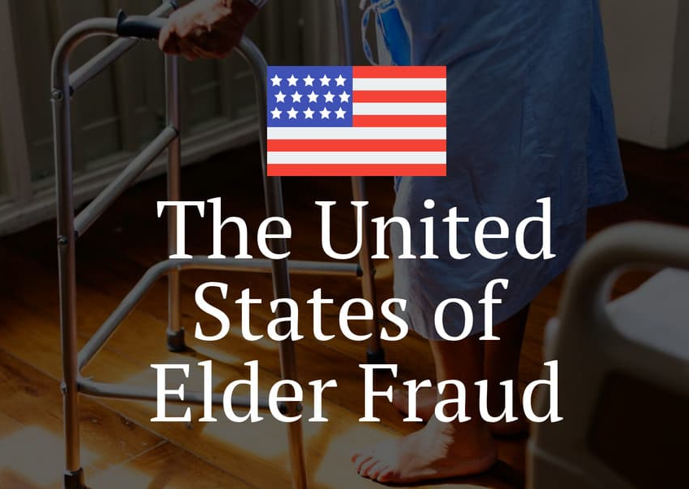
Cost of Financial Exploitation
Cost of elder financial exploitation in Utah is $92 million year
1 in 44 cases of financial exploitation are reported
Estimated cost to banks: $1 billion per year

Slide 16
Non-Financial Costs
Effects of financial exploitation:
19% evicted from home
10% turned to Medicaid
3x more likely to die

Slide 17
Vulnerability of Older Adults
Adults 50+ own 67% of bank deposits in the U.S.
Risk of exploitation is higher for socially and economically disadvantaged groups

Slide 18
Vulnerability
Cognitive issues associated with aging;
Mild Cognitive Impairment (MCI): Doesn’t interfere with daily life or function, but significantly impairs understanding financial concepts/ability to manage finances;
Estimated that 15-20% of adults over age 65 have MCI;
Financial impairment is earliest sign of cognitive decline: someone functioning well overall may be impaired in this area.

Slide 19
Family Dynamics
1 in 20 older adults (60+) will be financially exploited in their lifetime by a family member. Family is most common abuser.
Control finances by threats:
Move to nursing home/long-term care
Limit access to grandchildren/harm to pets
Control by promises: Care for the elder in exchange for control of finances
Barriers to cooperation:
Reluctant to get family member in trouble
Concern about losing caregiver, forced to move from home
Caretaker may feel entitled to funds/assets in exchange for care. Abuse starts small and snowballs.
Notes:
Examples to emphasize

Slide 20
Power Imbalance
Victim may be dependent on abuser, physically or emotionally.
Abuser may isolate the victim to increase this dependence, keeping family/friends away.
Abuser may hide victim’s glasses/hearing aids to prevent them from reading mail or talking on the phone.
May take phone away or forward mail.
Power imbalance between victim and abuser raises issue of undue influence.

Slide 21
Indicators of Financial Exploitation
Unusual charges on credit/debit card, or unusual withdrawals from bank account
ATM transactions for housebound victim
Abuser is financially dependent on victim
Bills are unpaid, utilities are shut off, or there is little food in the house
Victim suddenly has insufficient funds to cover usual needs
Victim doesn’t understand finances or know what assets they have
Property or valuables are disappearing

Slide 22
Indicators of Financial Exploitation Cont.
Recent change in will, property ownership, power of attorney
Victim has a new best friend or love interest helping with finances
Child/grandchild moves into victim’s home
Other risk factors for financial exploitation:
Grief
Social isolation
Living with a large number of unrelated people

Slide 23
Utilization of Financial Exploitation Auditor
APS has an in-house financial auditor and contracts with a forensic accounting firm, which may be utilized by law enforcement when APS has an open case on the same matter.
Analysis in complex cases with multiple accounts (including trust accounts), transactions, business entities, or properties
Ability to track transfers of funds, including who was responsible for transaction
Fraud detection
Distinguish between expenses on behalf of victim versus expenses benefitting suspect
Analyze budgetary issues and determine necessary expenses
Advice regarding propriety of gift, loan, or property transfer
Establish restitution amount
Notes:
*Advanced class
To utilize auditor, we must have an open case, if there is not an open case, we need to have them call intake and open one; as a reminder they have to meet the criteria for an allegation of financial exploitation and vulnerable adult to utilize this service. No dollar threshold, but there is a process for both internal financial audit and external which is utilized for more complex cases.

Slide 24
E-MDT Resources
Elder Justice Network Locator Map
Locate and collaborate with elder justice networks/teams across the nation.
Filter networks by state using the navigation tools, or search by a key word menu provided above the map
https://www.justice.gov/elderjustice/elder-justice-network-locator-map
E-MDTs are STRONGLY ENCOURAGED to add their team to the map
Please send network name, type, address, web address, and email to elder.justice@usdoj.gov

Slide 25
Top Scams Targeting Seniors
IRS/Social Securi
Imposter Scam (IRS, SS, Medicare)
Sweepstakes/Lottery Scams
Grandparent Scam
Affinity Fraud
Funeral/Cemetery Scam
Computer Tech Support Scam
Telemarketers
Romance Scam
Investment Scam/Ponzi Scheme
Counterfeit Prescription Drugs
Health Insurance/
Medicare Fraud
Home Repair Fraud
Notes:
Make sure emphasize that APS does not do scams. Provide handout on scams.

Slide 26
Reporting a Scam or Consumer Fraud
FBI Internet Crime Complaint Center (IC3)
IC3.gov
Consumer Financial Protection Bureau
855-411-2372
consumerfinances.gov
Federal Trade Commission
877-ID-THEFT
ftccomplaintassistant.gov
National Elder Fraud Hotline
833-FRAUD-11 (372-8311)
Utah Department of Consumer Protection (Fraud)
801-530-6601
Utah Department of Securities (Investments)
801-530-6600
Utah Insurance Department
801-538-3800

Slide 27
Document Requests
Document Requests and Subpoenas (Utah Code 62A-3-303)
Interagency Guidance on Privacy Laws and Reporting Financial Abuse of Older Adults (2013): “A financial institution may disclose nonpublic personal information to comply with federal, state, or local laws, rules and other applicable legal requirements, such as state laws that require reporting by financial institutions of suspected abuse. (15 U.S.C. 6802(e)(8) and implementing regulations at ___.15(a)(7)(i)).”

Slide 28
H.B. 459 Financial Exploitation Prevention Act
Utah Code 7-26-101
General Prevention of Financial Exploitation
Permitted delay of wire transfers
Permitted Acts to Prevent Financial Exploitation of Vulnerable Adults
Permitted notifications
Immunity

Slide 29
Gramm-Leach-Bliley Act (GLBA) 15 U.S.C. §6802
APS is duly authorized pursuant to the Gramm-Leach-Bliley Act (GLBA) 15 U.S.C. §6802 to obtain a customer’s financial records because APS has authority to conduct civil investigations, which include reviewing records, in order to prevent actual or potential fraud, such as vulnerable adult financial exploitation.

Slide 30
Immunity
Senior Safe Act: Provides immunity to eligible employees who have been
trained on identifying and reporting financial exploitation against seniors, and who act in good faith and with reasonable care.
Financial Exploitation Prevention Act: Provides immunity for covered financial
institutions and its employees who report suspected financial exploitation to APS, unless the report is made in bad faith. UCA 7-26-401(2)

Slide 31
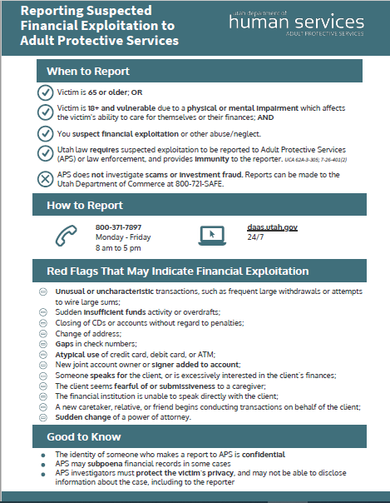
Resources – daas.utah.gov/protection
Reference Sheet
When to report
How to report
Red flags that may indicate Financial Exploitation
Good to Know

Slide 32
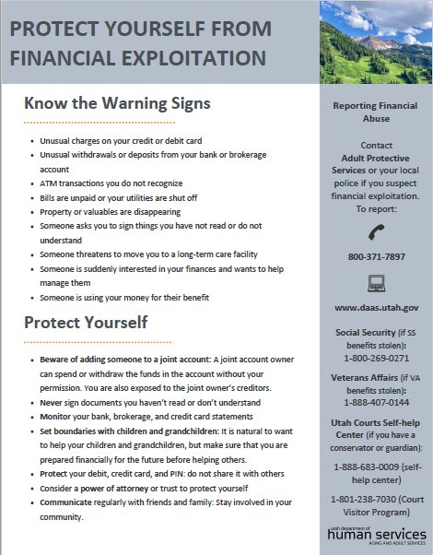
Resources – daas.utah.gov/protection
Financial Exploitation
Know the Warning Signs
Protect Yourself
Reporting Financial Abuse
Videos
Brochures

Slide 33
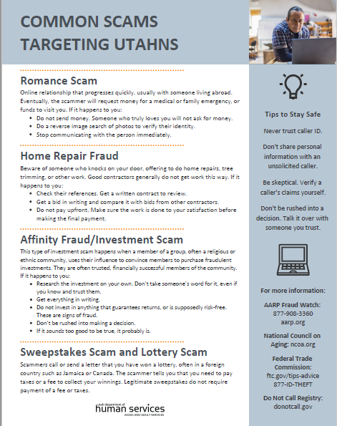
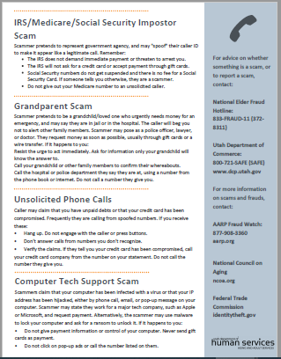
Resources – daas.utah.gov/protection
Tips to Stay Safe
Additional Resources
Reporting a Scam

Slide 34
Resources
Department of Justice
Senior friendly
Staffed with case managers
Victim focused

Slide 35
Training

Slide 36
Additional Training Resources
Elder Justice Initiative
https://www.justice.gov/elderjustice
EAGLE
https://www.justice.gov/elderjustice/eagle-elder-abuse-guide-law-enforcement
SAFTA
https://www.justice.gov/elderjustice/safta-senior-abuse-financial-tracking-and-accounting-tool-toolkit
NAPSA
https://www.napsa-now.org/
FinCEN
https://www.fincen.gov/
NW3C
https://www.nw3c.org/
IC3
https://www.ic3.gov/default.aspx
APS TARC (Technical Assistance Resource Center
https://apstarc.acl.gov/
Notes:
FINCEN & SARS

Slide 37
Resources for Working with Vulnerable Populations
Division of Aging and Adult Services
801-538-4171/ https://daas.utah.gov
Division of Services for People with Disabilities
801-538-4200 / https://dspd.utah.gov
Division of Substance Abuse and Mental Health
801-539-3939 / https://dsamh.utah.gov
Mobile Crisis Outreach Team (MCOT)
801-587-3000
Suicide Prevention Lifeline
1-800-273-TALK (8255) / https://suicidepreventionlifeline.org/
Utah Domestic Violence Hotline
1-800-897-LINK (5465)
Silver Alert: Similar to an Amber Alert, for adults 60+ with dementia
Notes:
Talk about Silver Alert is activated through local jurisdiction

Slide 38
Community Resources
Area Agencies on Aging (statewide):
https://daas.utah.gov/locations-new/
Meals on Wheels
In-home Services
Senior Transportation
Caregiver Support
Legal Services
Refugee Assistance (SLCo)
Utah Senior Health Insurance (SHIP)
Senior Medicare Patrol
Utah Senior Health Insurance
Alzheimer’s Association:
(800) 272-3900 24 hours
(801) 265-1944 Utah Chapter
Family Justice Center (Salt Lake & Utah County):
(801) 537-8600 (SL) / (801) 851-8554 (UC)
Utah 211: https://www.211utah.org
Utah Aging: https://www.utahaging.org

Slide 39
Additional Financial Resources & Reporting
Medicaid Fraud Control Unit (MFCU)
(801) 281-1259
AARP Fraud Watch Network:
(877) 908-3360; aarp.org
National Council on Aging
ncoa.org
Money Smart for Older Adults
fdic.gov/consumers/consumer/
moneysmart/olderadult.html
Do Not Call Registry
donotcall.org
Social Security Administration (if benefits misused/stolen)
(800) 269-0271
Veterans Affairs (if VA benefits misused/stolen)
(888) 407-0144
Utah GRAMP (if conservator or guardian involved)
(801) 578-3925

Slide 40
Let’s all take part in a holistic approach to combat abuse of vulnerable adults!

Slide 41
